Slide 1

From Concept to CRAN: The Complete R Package Development Cycle
Renzo Caceres Rossi
arenzocaceresrossi@gmail.com

Slide 2

¿Where’s the Package?
¿Where is the Package?
¿Where is the Library?
¿Where is your Package?
¿Where is your Library?

Slide 3
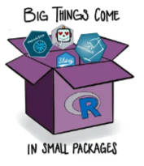
Why develop a package?
Differentiation
Skills test
Technical portfolio
Academic citations
De facto standard
Thesis, paper, article

Slide 4

What exactly is an R package?
Collection of functions, data, and documentation packaged for a specific task
Extend R's capabilities for specific areas
Download and installation from CRAN or GitHub
Approximately 20,000 to 21,000 packages published as of 2025.
It’s the heart of R, Python, and Julia as well.

Slide 5
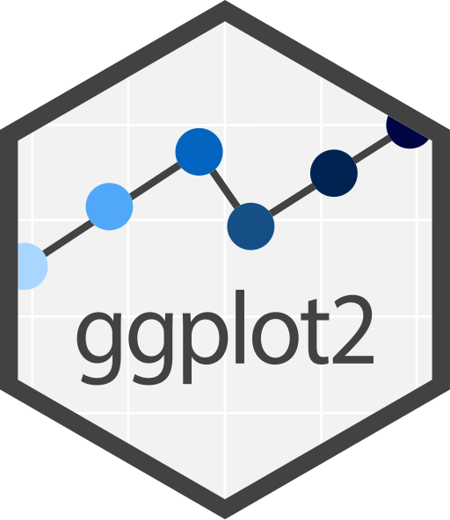
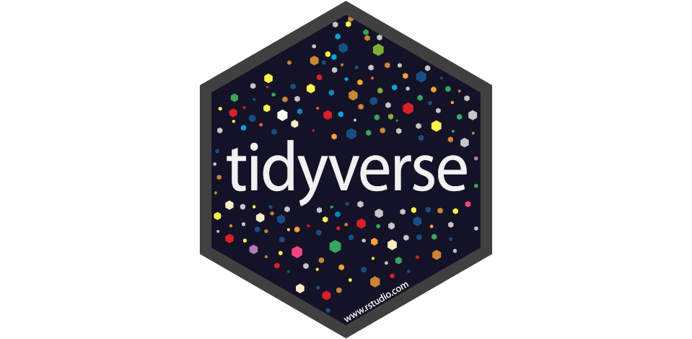
Types of packages in R
Datasets Package
Datavisualization Package
Metapackage

Slide 6
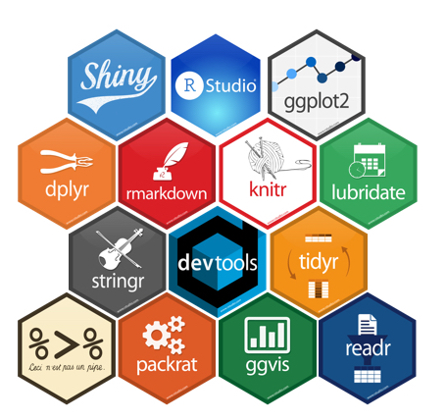
R Packages Ecosystem

Slide 7

Not a One-Hit Wonder Build Many R Package

Slide 8
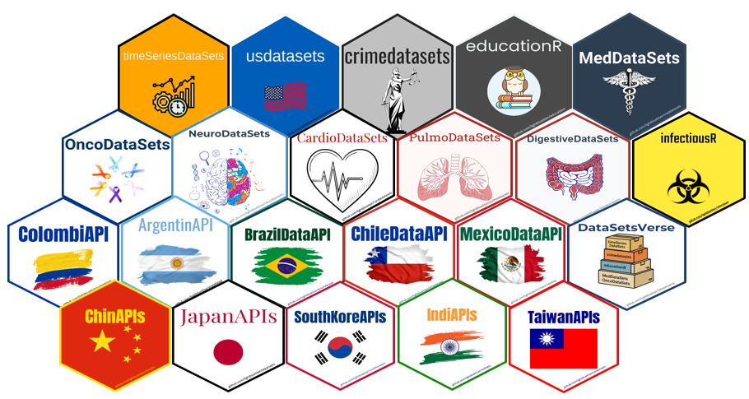
Your Packages, Your Own Ecosystem in R

Slide 9
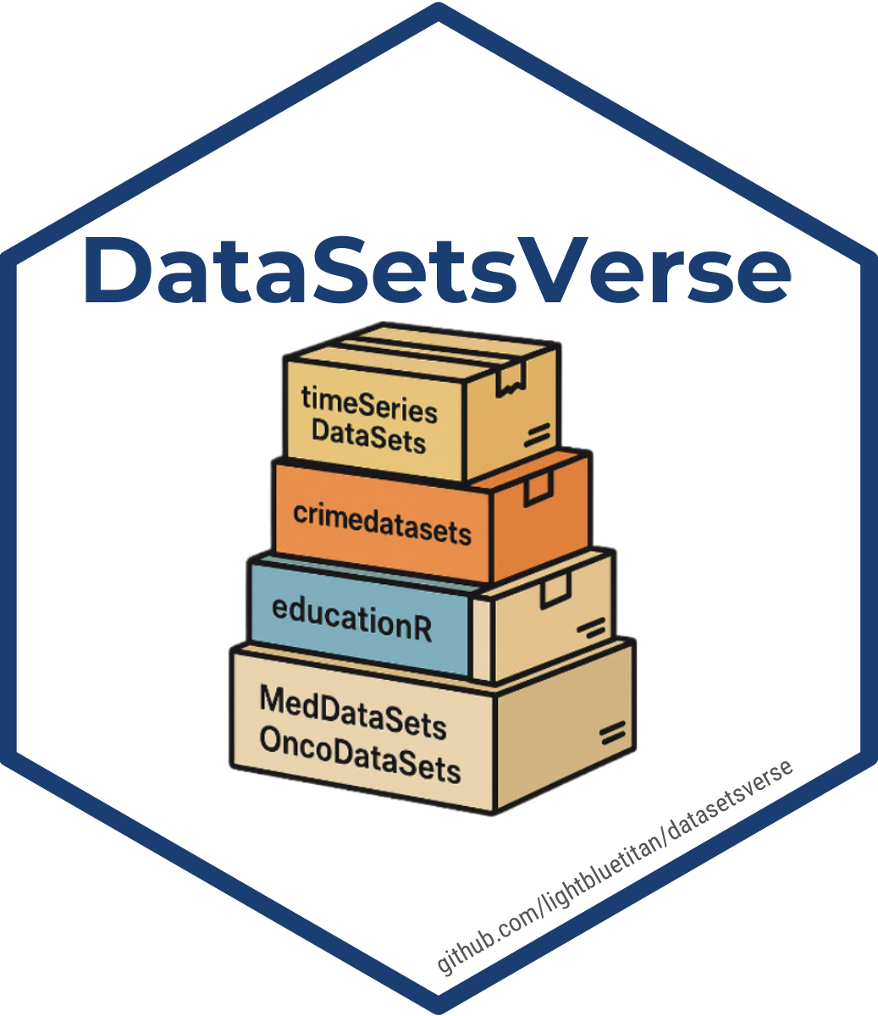
Your Metapackage, Your Universe in R

Slide 10
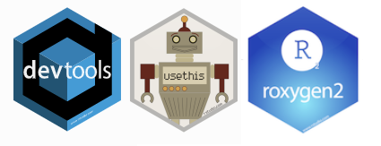
R Package Development
Time to build our very first R package!

